Slide 1




Performing More Advanced Actions

Slide 2

Overview
Dialogs (JavaScript pop-ups)
Download and upload files Console events and errors
Cookies and browser storage Run custom JavaScript
Screenshots
Frames and Iframes

Slide 3

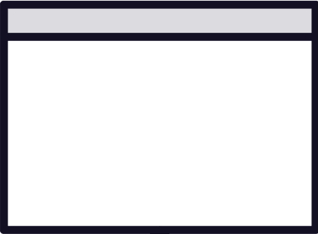
Dialogs
Alert OK
Confirm OK-Cancel
Prompt Input + OK/Cancel

Slide 4

Playwright dismisses dialogs by default

Slide 5


Downloads
Verify that:
Link is valid
File is the correct one
How to verify a successful download?

Slide 6

Downloads in Playwright
Deleted after browser context closure
Test terminated half-way? No clean up.

Slide 7

Downloads
Non-previewable files
In headed and headless
Previewable
Headless only

Slide 8
Playwright dismisses dialogs by default
page.on(‘some_event’, doThing)
Summary
API for cookies
page.evaluate(customJavaScript)
Downloading behavior depends on type of file
page.screenshot({ your config })
Use frameLocator for Frames and Iframes

Slide 9

Up Next:
Harnessing the Power of Playwright’s Test Runner

